Slide 1

Macroeconomics II
Lecture 07 (March 2023)
The Solow model
Diagram and functioning of the model
1
Notes:
1

Slide 2
Theoretical Lecture 7
The Solow model of economic growth
the hypotheses of the Solow model;
the Cobb-Douglas production function (to remind);
the production function per capita;
the Solow model;
equilibrium in the Solow model: the steady state.
Reading:
Louçã & Mortágua (2021), Chapter 12
Jones & Vollrath (2013), Introduction to Economic Growth, Norton, chap 2, pp. 20 – 53
2
Notes:
2

Slide 3
3
Notes:
3

Slide 4
Robert Solow, Nobel Prize Lecture, December 1987
“Growth theory did not begin with my articles of 1956 and 1957, and it certainly did not end there. Maybe it began with The Wealth of Nations; and probably even Adam Smith had predecessors. More to the point, in the 1950s I was following
a trail that had been marked out by Roy Harrod and by Evsey Domar, and also by Arthur Lewis in a slightly different context. Actually I was trying to track down and relieve a certain discomfort that I felt with their work. (…)”
4
Notes:
4

Slide 5
Neoclassical economists and the models of economic growth
Criticisms to Harrod-Domar model by Robert Solow
capital-output ratio as a constant is not a realistic hypothesis
relevance of labour: it is implicit (given complementary factors), but not explicit in the model
The response by Robert Solow: new hypotheses
  GDP depends on physical capital and labour, with decreasing returns
  Production function with substitutable factors
5
Notes:
5

Slide 6
(…) That was the spirit in which I began tinkering with the theory of economic growth, trying to improve on the Harrod-Domar model. I can not tell you why I thought first about replacing the constant capital-output (and labour-output) ratio by a richer and more realistic representation of the technology” (Solow)
production function
Harrod-Domar: Y = F(K,L) = min (AK, BL), with complementary factors
Instead, the Neoclassical models: with substitutable factors
Solow basic model: Y(t) = F(K(t), L(t))
if you add technology: Y(t) = F (K(t), A(t).L(t))
A and L enter multiplicatively. AL is the effective labour, and technology (exogenous) enters as labour-augmenting or Harrod-neutral technological progress;
equilibrium paths (steady-state): it is not a mechanical equilibrium, but instead an equilibrium path, and, behind it, there are economic dynamics that support such steady-state equilibrium
6
Notes:
6

Slide 7
The hypotheses of the Solow model
the economy is represented by a production function with two substitutable production factors (capital, labour);
the production function exhibits constant returns to scale;
the production factors have positive decreasing marginal productivities;
domestic savings is a fixed proportion of GDP;
the macroeconomic equilibrium in the economy is: I = S;
there is no unemployment;
the growth rate of active population is equal to the growth rate of total population;
the economy is closed.
7
Notes:
7

Slide 8
the basic Solow model
The model is explained by two equations:
  production function
  capital accumulation equation
A. The production function (basic: with no technical progress, yet …)
Cobb-Douglas (remind the properties: lecture 06)
Y = F(K, L) = K^{α} L^{1-α} , 0 < α < 1
α partial elasticity of Y relative to K (math. interpretation)
α remember the economic interpretation?
8
Notes:
8

Slide 9
Now take the per capita production function
per capita here means per worker
Y/L = F(K/L)
since y = Y/L and k = K/L, the production function Cobb-Douglas per capita is:
y = k^{α} , 0 < α < 1
interpretation:
if K/L is higher, the firms produce higher Y/L (this is the productivity of L);
for each additional unit of capital per worker, the increase of output per worker
becomes lower;
9
Notes:
9

Slide 10
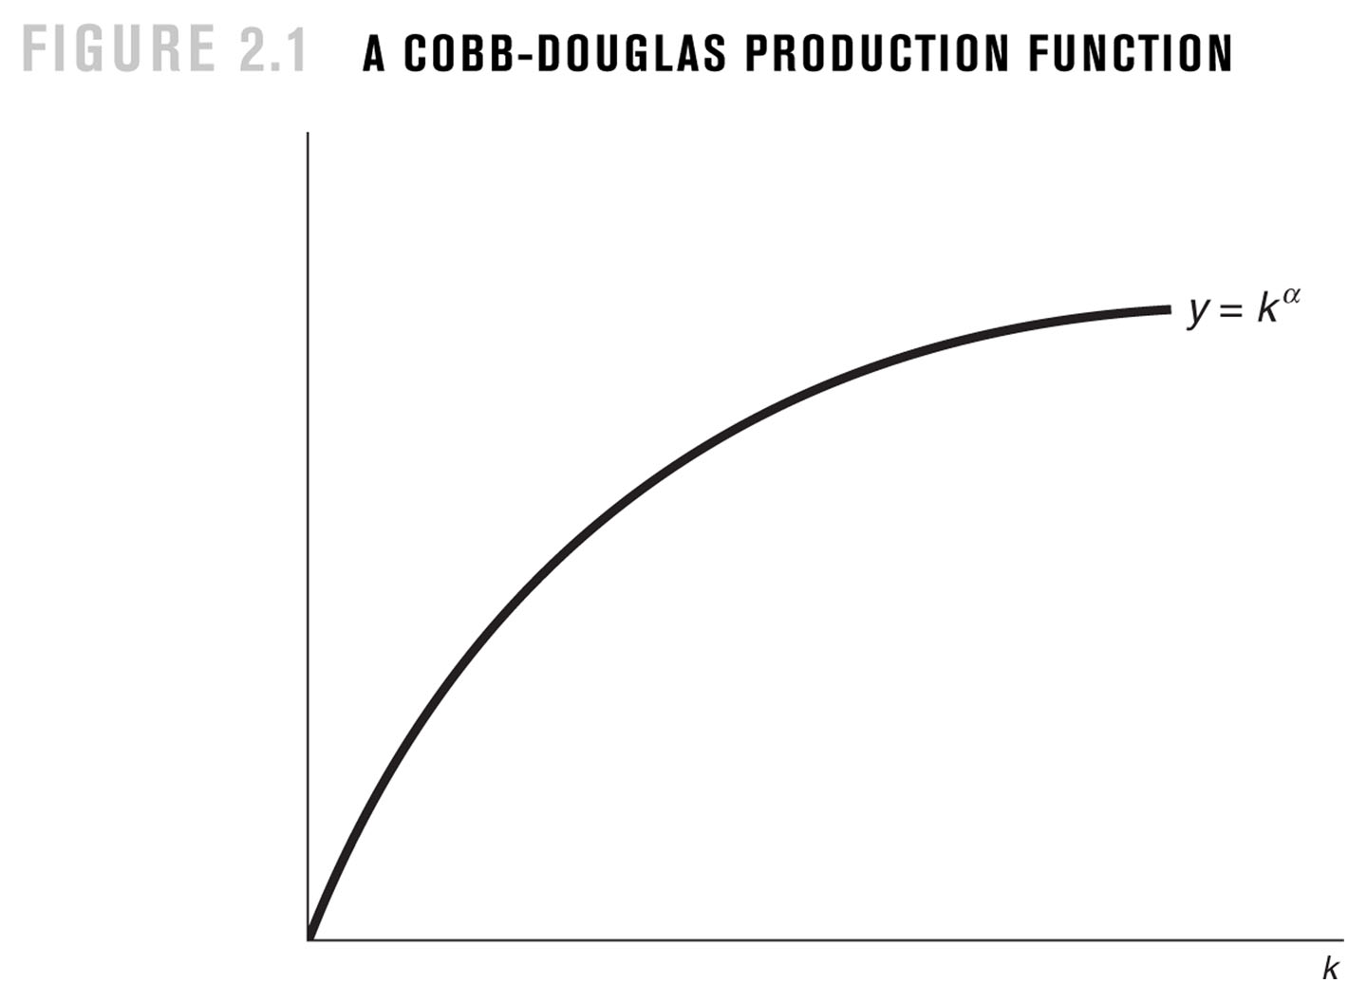
10
Notes:
10

Slide 11
And the second equation is:
B. the accumulation of capital equation
K_{t+1} – K_{t} discrete time
= s.Y – δ.K where, as you know, sY=S=I
dK/dt continuous time
(dK/dt)/K = s.Y/K – δ this is the growth rate of the stock of capital
the accumulation of capital equation per worker
k = K/L
ln k = ln K – ln L
(dk/dt)/k = (dK/dt)/K – (dL/dt)/L growth rate of the stock of capital per capita
11
Notes:
11

Slide 12
Take also the growth of the active population:
L(t) = L₀ e^{nt}
If you consider that the active population grows at the same rate as population, then
(dL/dt)/L = n
(dk/dt)/k = (dK/dt)/K – (dL/dt)/L
= s.Y/K – δ - n
= s. y/k – δ– n
and then dk/dt = s.y – (n + δ).k
12
Notes:
12

Slide 13
Thus, the Solow model can be summarised as:
1) y = k^{α} , 0 < α < 1 production function per capita
2) dk/dt = s.y – (n + δ).k stock of capital variation per capita
or, dk/dt = s. k^{α} – (n + δ).k
the model addresses the following question:
If an economy has, in some year, the stock of capital per worker k₀, the growth rate of population is n and the stock of capital depreciates at the rate δ, what is the trend of output per worker in this economy? How does this economy compares to another one with a different rate of investment?
13
Notes:
13

Slide 14
s. k^{α} actual investment per capita (per worker)
(n + δ).k investment per capita (per worker) that is required
to keep the stock of capital per capita (per worker) constant
when s.k^{α} > (n + δ).k, then dk/dt>0, the economy increases the stock of capital
per capita (worker);
Or capital deepening of the economy;
when s.k^{α} = (n + δ).k, then dk/dt=0; when k = k*, the stock of capital K is rising
at the growth rate n>0 (the same as that of active population);
But the stock of capital per capita (worker) is not growing (rate of growth = 0);
Or capital widening of the economy.
14
Notes:
14

Slide 15
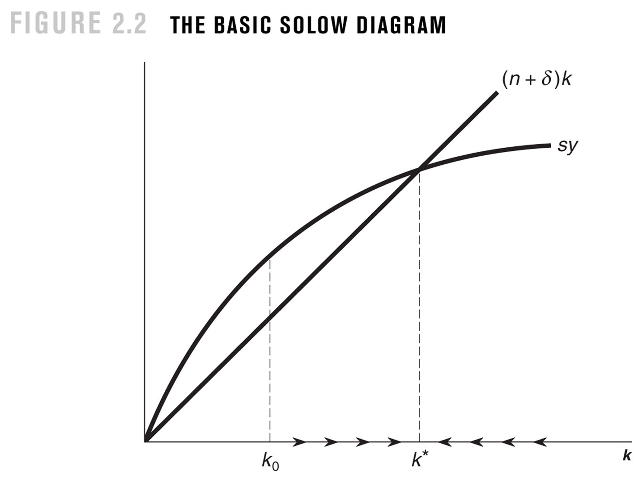
Introduction to Economic Growth, 3rd Edition
Copyright © 2013, W.W. Norton & Company
Notes:
15
FIGURE 2.2 THE BASIC SOLOW DIAGRAM

Slide 16
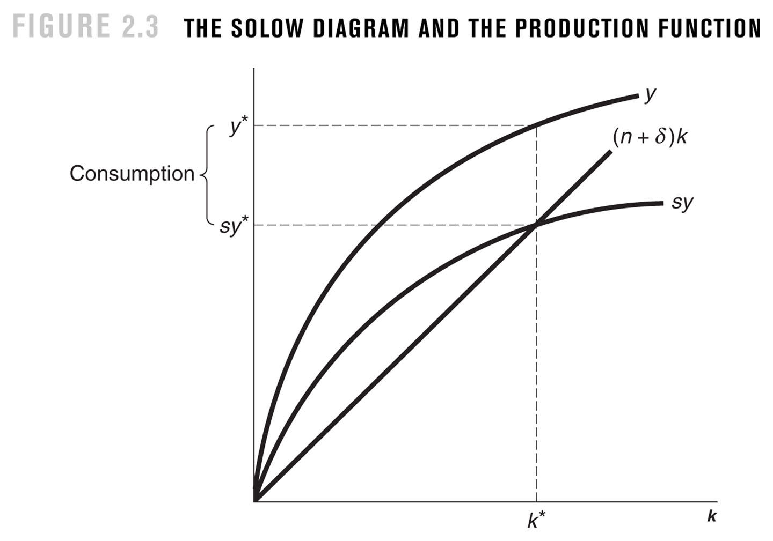
the dynamic equilibrium in
the Solow model (steady-state)
If dk/dt = s.y – (n + δ).k = 0
in the steady state, k = K/L remains constant
K grows at the same rate as L
or, K grows at the rate n
This is the case of capital widening
16
Notes:
16

Slide 17
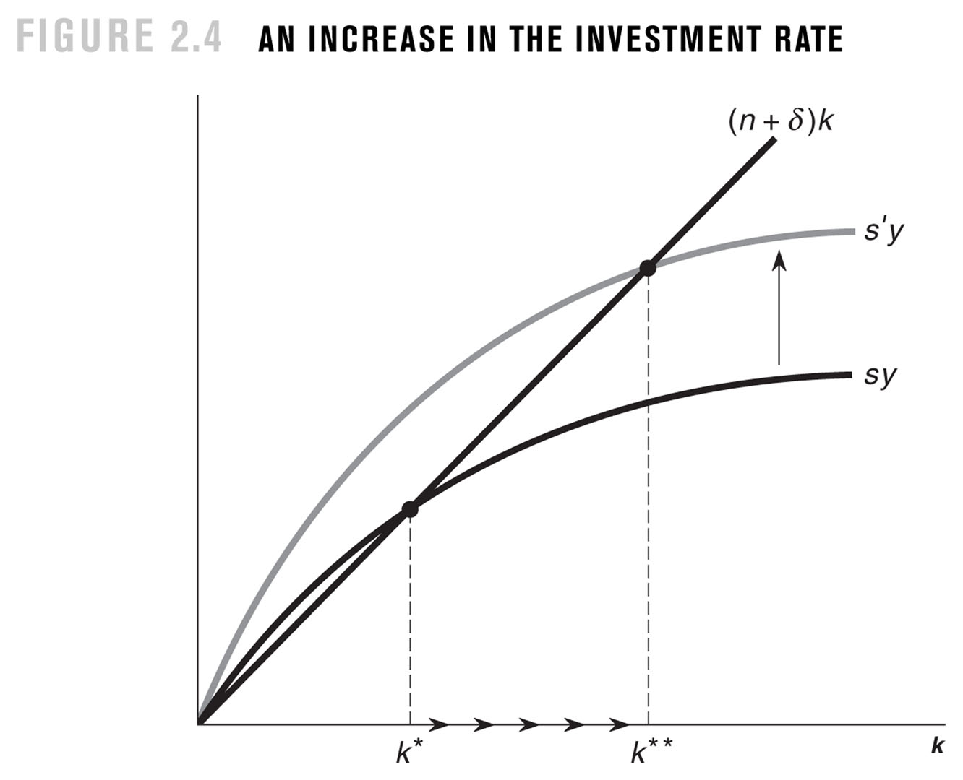
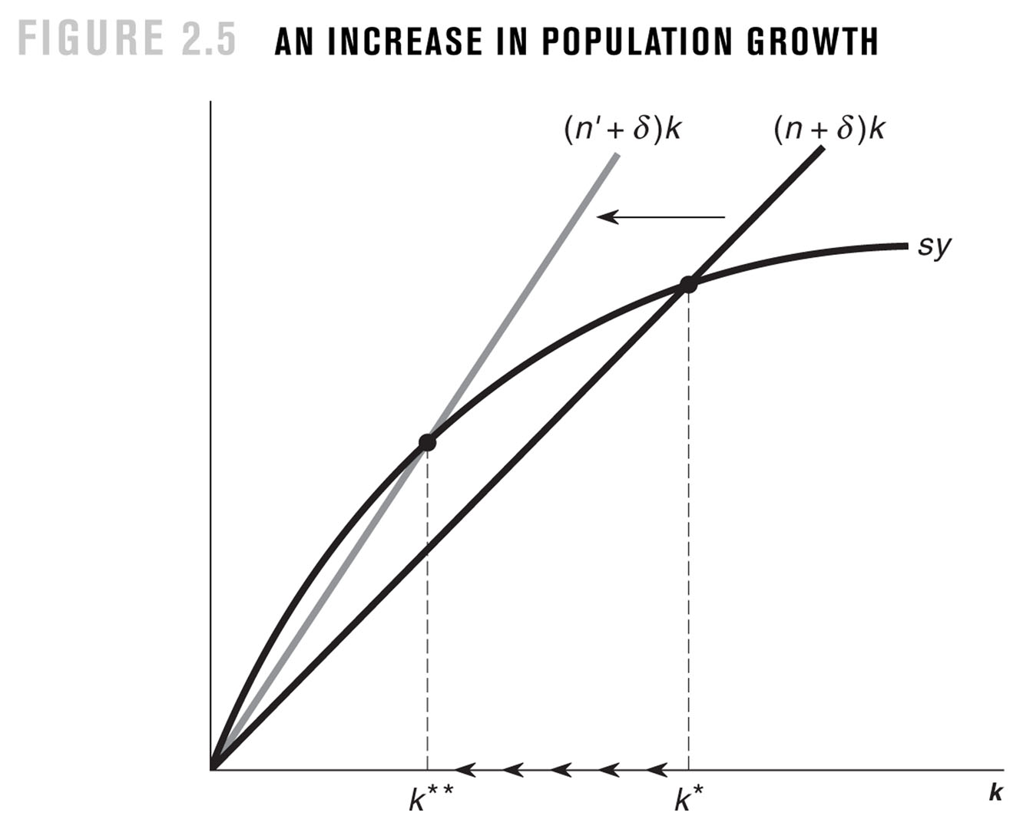
comparative statics
17
Notes:
17

Slide 18
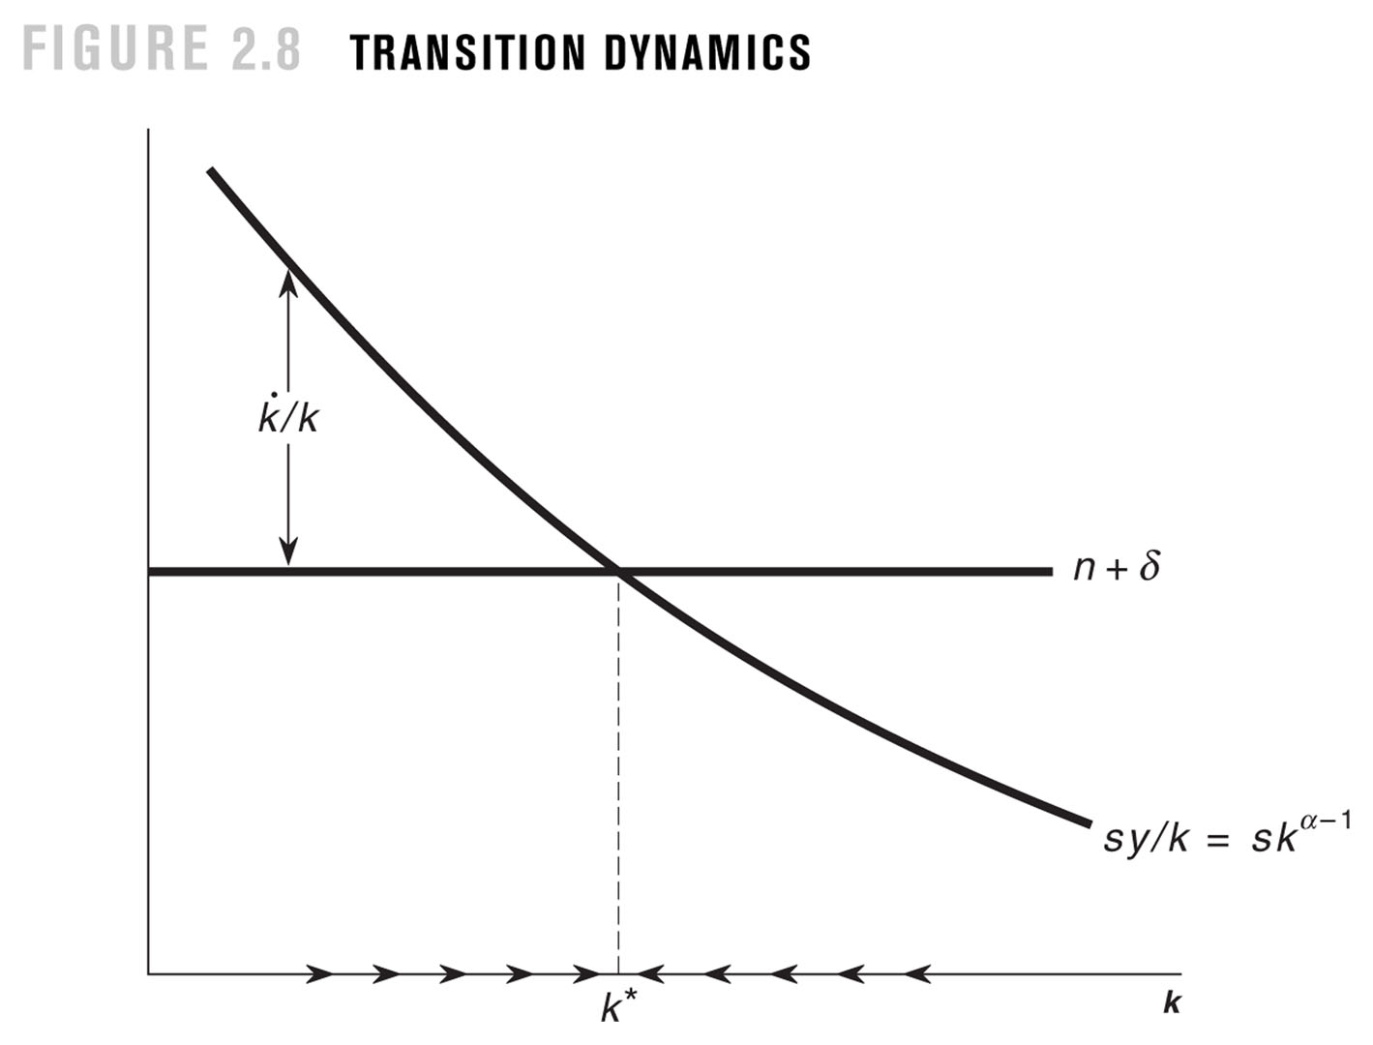
Solow model: the transition dynamics
(rates of growth)
dk/dt = s.k^{α} – (n + δ).k
(dk/dt)/k = s.k^{α-1} – (n + δ)
decreasing growth rate
in the transition to steady-state
diminishing returns to
capital accumulation
y = k^{α} 0 < α < 1
18
Notes:
18

Slide 19
the steady-state:
interpretation and empirical evidence
as dk/dt=0 (since this is a steady state) we have:
s.k^{α} = (n + δ).k
k* = (s/(n + δ))^{1/(1-α)}
y* = (s/(n + δ)) ^{α/(1-α)}
interpretation:
countries with higher savings rate are richer
countries with higher population growth rates are poorer
19
Notes:
19

Slide 20
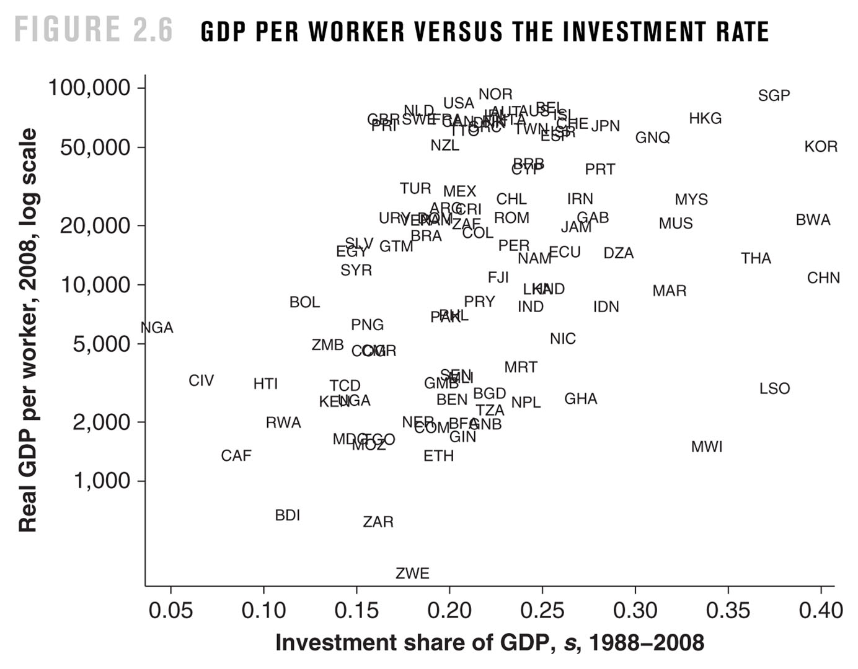
Does the model describe reality?
20
Notes:
20

Slide 21
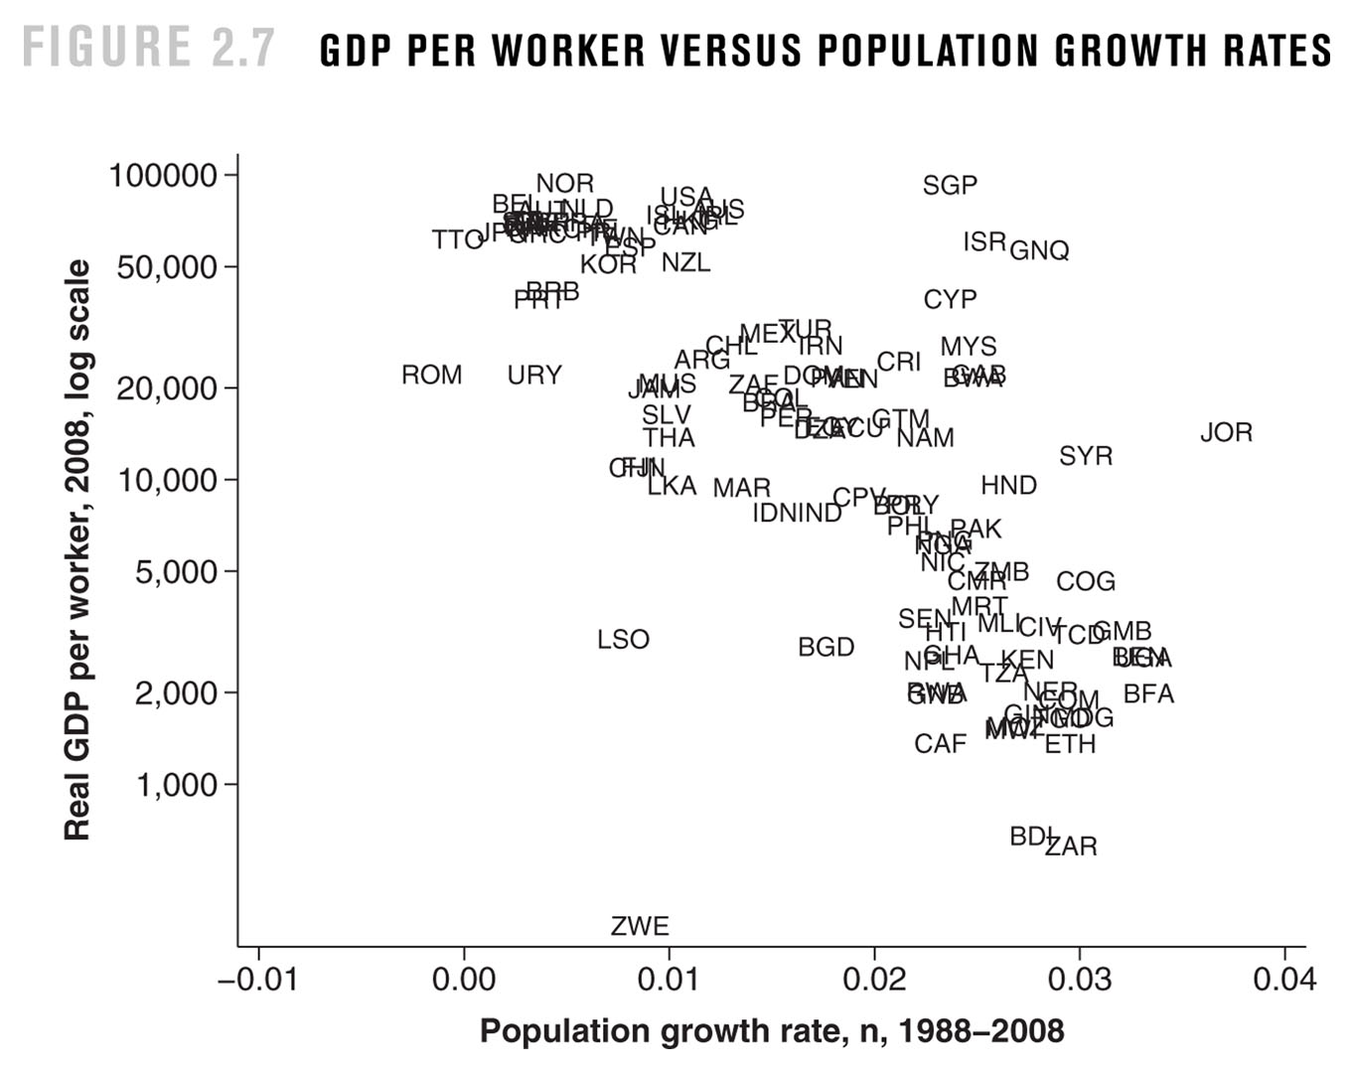
21
Notes:
21

Slide 22
Concluding remarks
In the steady state:
k#* = (s/(n+g+δ))^{1/(1-α)}
y#* = (s/(n+g+δ)) ^{α/(1-α)}
y* = A(t) . (s/(n+g+δ)) ^{α/(1-α} (since y# = y/A) (remember: y=Y/L; y# = Y/AL)
the GDP per worker, y, in steady state (that is, in the balanced growth path) is determined by technology, A(t), and its rate of growth (g), by the investment rate (s) and by the population growth rate (n).
In the steady state, the growth rate of the GDP per worker, y, is equal to the growth rate of technology (g); and the growth rate of GDP (of Y) is equal to the growth rate of technology (g) plus the population growth rate (n).
22
Notes:
22

Slide 23
main conclusions/contributions of Solow model
each economy has characteristics that determine its steady state (when the economy grows at a rate such that the amount of capital per worker is constant)
the main characteristics of the economy that determine its steady state are:
investment (= saving) rate, rate of population growth, rate of technological progress
The Solow model is a theory of income differences among countries
countries may have different steady states;
countries (even with the same steady state) may be not at their steady state: in this case, these economies may have different income levels;
if an economy has an income level different from its steady state income level, then it moves into its steady state income level;
The Solow model is a theory of relative growth rates
two “similar” countries with the same rate of investment have the same steady state
income level, but may have different income levels (if they are not at their steady state) ; in this case, the poorer income level country (that more distant to its steady state) grows faster into its steady state income level: conditional convergence
23
Notes:
23

Slide 24
Comparison between the Harrod-Domar and the Solow models
Harrod-Domar: output growth adjusts to the capital-output ratio (which is exogenous)
Solow: capital-output ratio is endogenous, and adjusts to the output growth, which is exogenous (determined by exogenous factors: population growth and technological progress)
24
Notes:
24

Slide 25
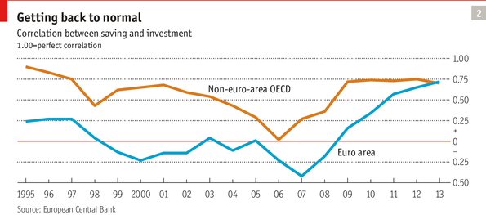
Theory and reality: is is true that S=I?
in a real open economy it is not
Notes:
25

Slide 26
Conclusion:
what is crucial in the Solow model
1. the assumption of diminishing returns to capital: economies that have less capital per worker (relative to their long-run capital per worker) tend to have higher rates of return and, then, higher growth rates;
2. in the Solow model, the economic policy may change the growth rate of GDP per capita but such change is temporary during the convergence to a new steady state; they do not have long-run effect on economic growth;
3. in the Solow model, economic policy may permanently change the long-run level of GDP per capita.
26
Notes:
26

